Slide 1
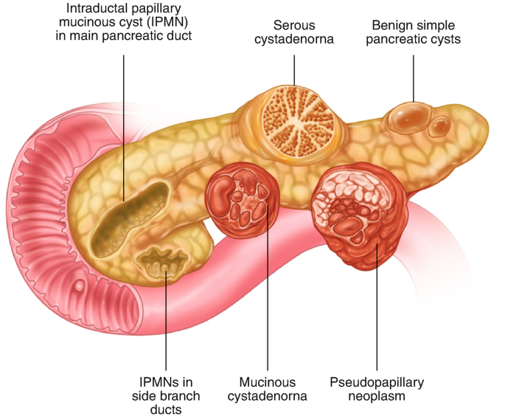
Pancreatic Cystic Neoplasms Challenging Cases
Mohamad reza fazli MD

Slide 2
Pancreatic Cystic Neoplasms

Slide 3
Kromrey M-L, et al. Gut 2018;67:138–145.
A prevalence of 49.1% ; An incidence of 12.9% during 5-year follow-up
63.6% had cysts <5 mm, 30.6% between 5.01 and 10 mm, 5.1% between 10.01 and 20.00 mm, and only 0.7% >20 mm.
Pancreatic cancer : None
The prevalence of pancreatic cysts in the general population is unexpectedly high. Pancreatic cysts are the most common pancreatic neoplasms.

Slide 4
Case 1
Patient A 71-year-old male
epigastric pain and early satiety
US a hypoechoic mass lesion in the body of pancreas
CA 19-9 2 U/ml

Slide 5
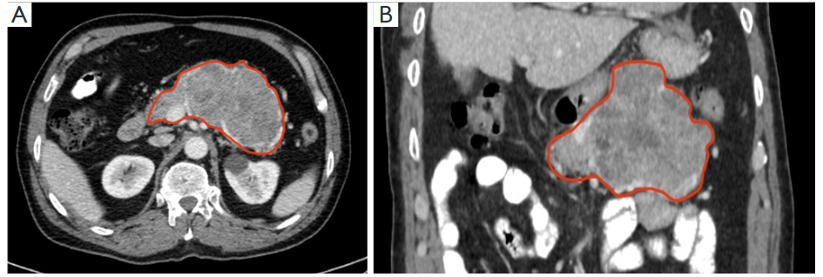

Slide 6
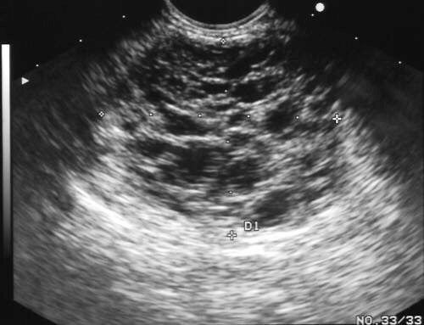
A hypoechoic, multicystic lesion, with honeycombing pattern, no obvious communication with the pancreatic duct, without evidence of an associated solid mass.

Slide 7
Case 1
Probable Diagnosis?
Next step: EUS-FNA, surgery, follow-up?

Slide 8
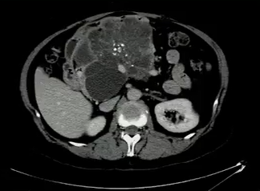
Don’t call the surgeon *!
Serous cystadenoma
* Unless symptoms are present.

Slide 9
Case 1
Serous Cyst Adenoma
No need to EUS-FNA, surgery or follow-up

Slide 10
Case 2
25 years old woman.
Medical student.
No personal medical history.
No family history for neoplastic diseases.
Smoking 10 sig/day; No alcohol or drugs.

Slide 11
Case 2
Occurance of abdominal pain and dyspepsia.
Blood examination: Normal.
Abdominal ultrasound: 5 cm cystic lesion in pancreatic tail.

Slide 12
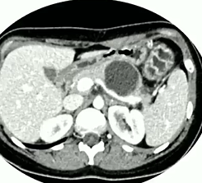
Case 2
CT scan
Cystic lesion in the pancreatic tail of 52*54mm, unilocular, with thick wall and with upstream dilation of pancreatic duct (4mm).

Slide 13
Diagnostic hypothesis
Mucinous cystadenoma
IPMN-BD with pancreatic duct dilation
Serous cystadenoma
I don’t know

Slide 14
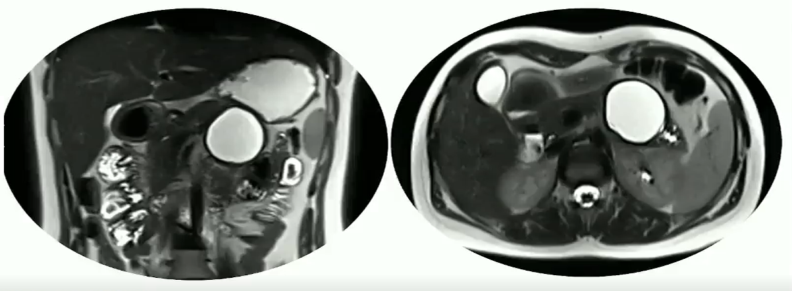
MRI: Unilocular pancreatic cyst of the body-tail, without mural nodule and with upstream dilation of pancreatic duct (4mm); Connection to PD???

Slide 15
What next?
Endoscopic ultrasound + FNA
Endoscopic ultrasound + microforceps biopsy
Surgical evaluation
Follow-up

Slide 17
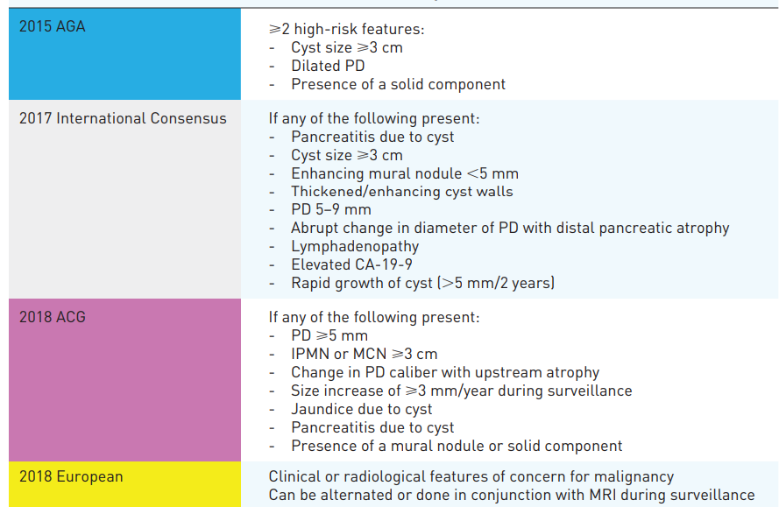
Indications for Endoscopic Ultrasound
Ross, et al. Ther Adv Gastrointest Endosc 2021; 14: 1-21.

Slide 18
(< 10-15mm)
(certain)

Slide 19
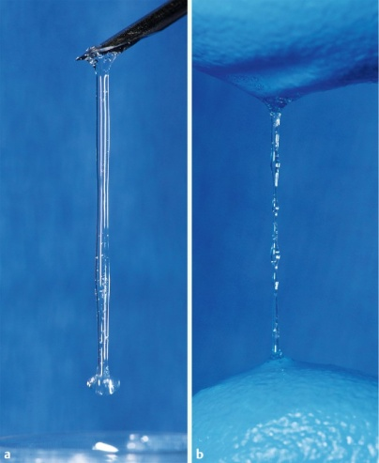
PANCREATIC CYST
ROLE OF EUS-FNA
Aspiration of fluid - Limitation = a size of 1.5 cm was the minimum required to obtain fluid for at least one analysis
MACROSCOPIC
CYTOPATHOLOGICAL
EXAMINATION
BIOCHEMICAL
ANALYSES
CEA is the most useful to differentiate mucinous from non-mucinous cysts
Amylase may also be useful because a value <250U/L
virtually excludes a pancreatic pseudocyst
Very low sensitivity
But
Strongly correlated with the risk of malignancy if positive !
Meta-analysis
(18 studies, 1438 patients)
Thornton GD et al., Pancreatology 2013
STRING SIGN
string length >3.5 mm indicates a mucinous cyst
Sensitivity = 58 % (95 %CI, 44 % – 70 %)
Specificity = 95 % (95 %CI, 83 % – 99 %)
Bick B et al., Endoscopy 2015

Slide 20
A total of 226 patients underwent surgery
150 MCNs and 76 NMCNs cases
CEA cutoff of
105 ng/Ml: a sensitivity and specificity of 70% and 63%, respectively.
192 ng/mL: a sensitivity of 61% and a specificity of 77% and would misdiagnose 39% of MCN cases.
Cyst fluid CEA levels have a clinically suboptimal accuracy level in differentiating MCNs from NMCNs.

Slide 21
2021;94:698-712.
Glucose <50 mg/dl in pancreatic fluid – suggestive of mucinous lesion
The pooled sensitivity for pancreatic cyst fluid glucose was significantly higher compared with CEA alone (91% vs 56%; P < .001) with no difference in specificity (86% vs 96%; P > .05).
Diagnostic accuracy was significantly higher for pancreatic cyst fluid glucose versus CEA alone (94% vs 85%; P < .001). Combination testing with pancreatic cyst fluid glucose and CEA did not improve the diagnostic accuracy compared with glucose alone (97% vs 94%; P > .05).
Conclusions: Low pancreatic cyst fluid glucose was associated with a high sensitivity and specificity with significantly improved diagnostic accuracy compared with CEA alone for the diagnosis of mucinous versus nonmucinous pancreatic cystic lesions.

Slide 22
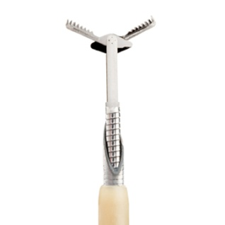
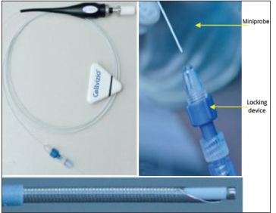
PANCREATIC CYST
THE FUTURE = DIRECT SAMPLING AND ANALYSIS OF THE WALL
FNB of the wall
Use of beveled needle
++ for nodule and wall thickening
Adequate material in 65 to 81% of cases
Use of confocal laser endomicroscopy probe introduced through a 19G needle
Use of micro forceps biopsy through a 19G needle
Use of a brush through a 19G needle
RISK OF BLEEDING !
EVALUATION IN PROGRESS…

Slide 24
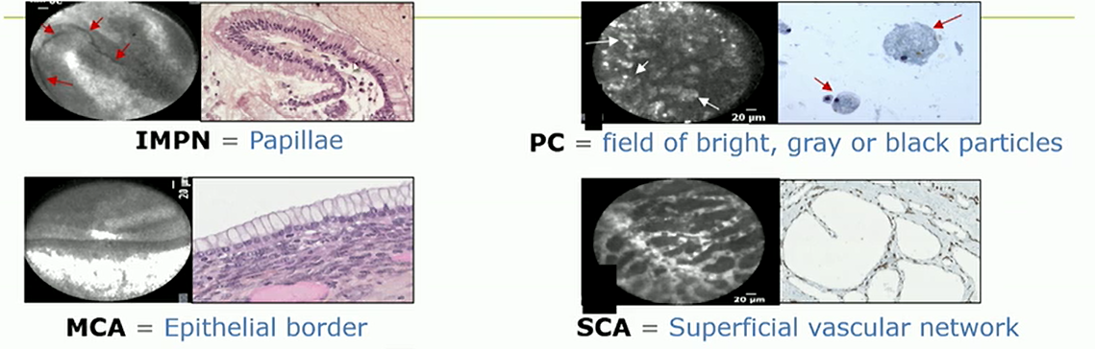
Finger like projections

Slide 25
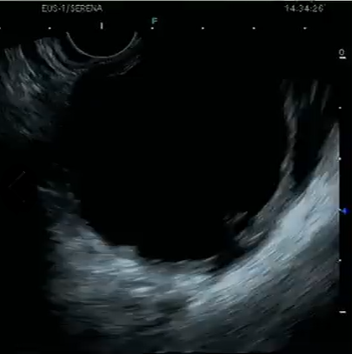
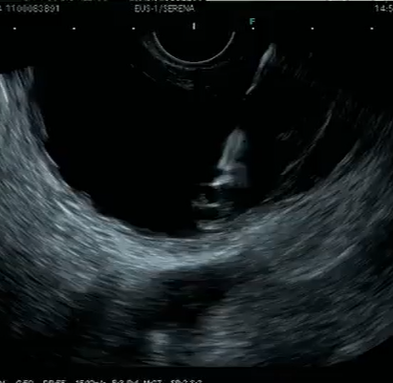
Case 2
EUS + through the needle biopsy.
Unilocular cystic lesion of pancreatic body-tail, no mural nodule, no septation, no PD connection, mild (3.5mm) PD dilation in tail. 50 ml of transparent cystic fluid was obtained and was sent for cytological analysis and biochemical markers. Biopsy with microforceps was taken from the cyst wall .

Slide 26
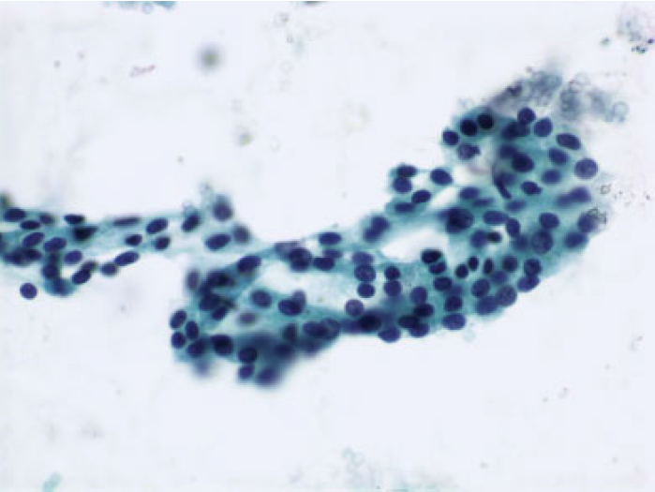
Case 2
Histological evaluation:
Cuboid epithelium without malignant features, suggestive for serous cystadenoma.
Cystic fluid analysis: CEA 173, amylase 250, glucose 75

Slide 27
Case 2
Celebrate!
Patient was fine, no pain.
But after 6months ….
…… new occurence of mild abdominal pain and dyspepsia

Slide 28
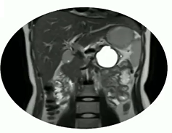
Case 2
MRI:
Unilocular pancreatic cyst of the body-tail, 50*50mm, without mural nodule, with thick wall, with atrophy of the paranchyma of the pancreatic tail and with upstream dilatation of PD (4mm).

Slide 29
What next?
Endoscopic ultrasound + FNA
Endoscopic ultrasound + microforceps biopsy
Surgical evaluation
Follow-up

Slide 30
Case 2
No indication for surgery (at now) due to:
Young age
Benign lesion
Few symptoms
Patient’s will
UGIE: normal, negative for helicobacter infection
Good response to PPI and low-dose nortriptyline

Slide 31
Final diagnosis
Case 2
Functional dyspepsia
Recommendation
Medical follow-up
No surveillance

Slide 32
Case 3
Patient Asymptomatic 56 yr old male
Hx DM type 2
No familial history of pancreatic disease
No smoking or alcohol abuse
MRI/MRCP 12mm cyst in pancreatic head
No MPD dilatation, no nodule
Serum CA 19.9 15U/ml

Slide 33
Case 3
Small unspecified cyst
EUS?
Follow or neglect?

Slide 34
Kromery. GUT 2018;67:138-145

Slide 36
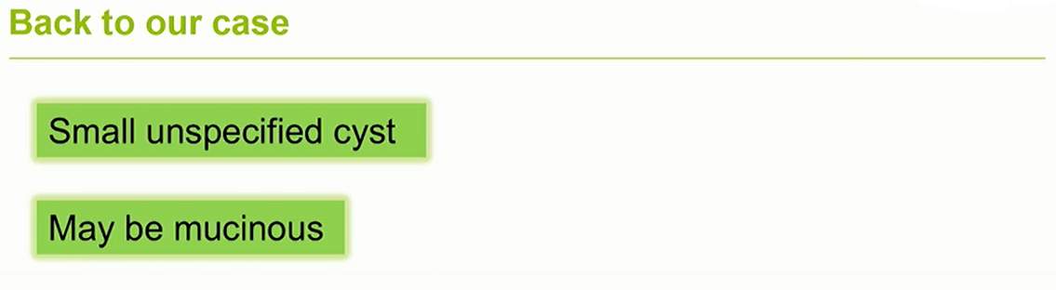

Slide 37
Case 4
Patient 70 yr old male
Hx of myocardial infarction
Asymptomatic
MRI/MRCP 2.3 cm cyst in uncinate process
Connected to MPD
No PD dilatation, no solid components
Serum CA19.9 22 U/ml

Slide 38
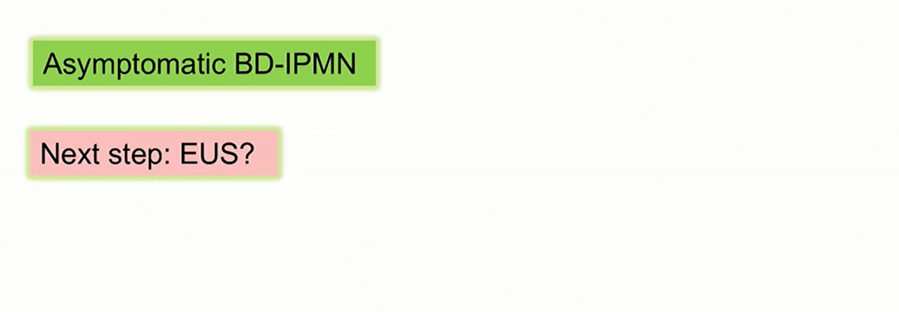
Case 4

Slide 41
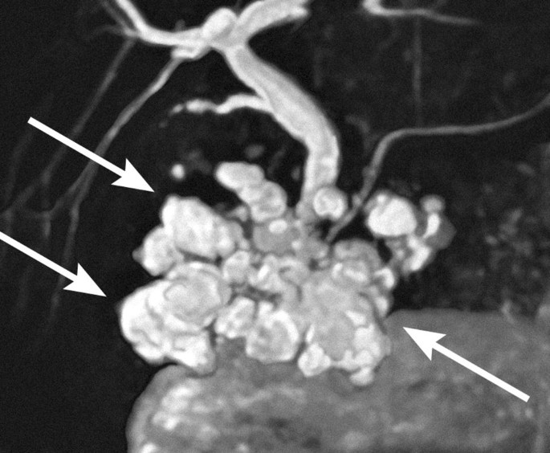
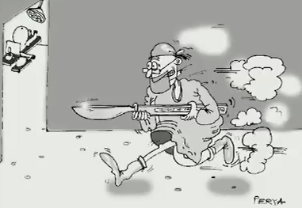
Call the surgeon *
Branch duct IPMN
* To “watch the movie” together

Slide 42
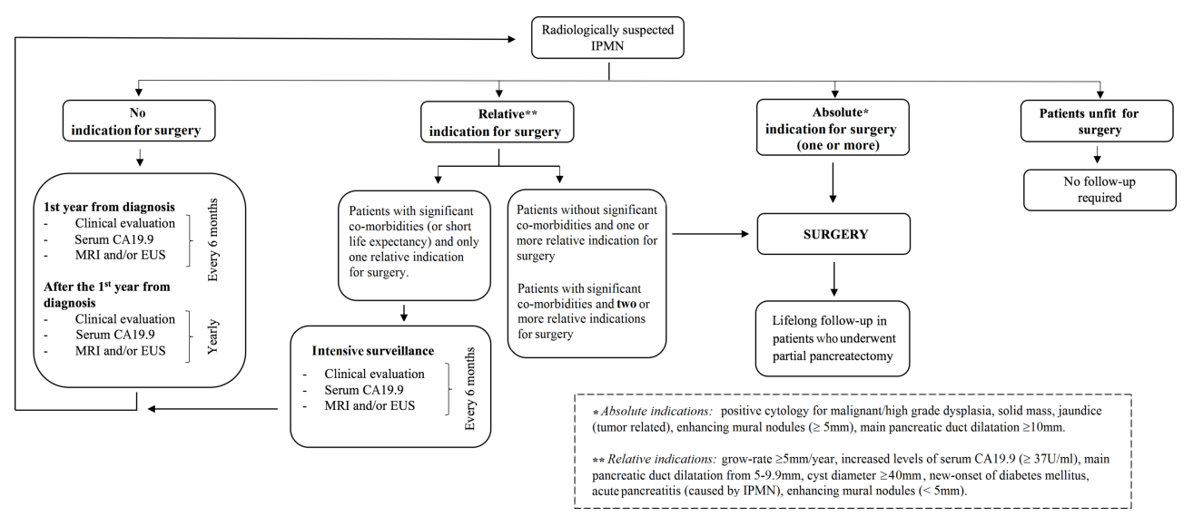

Slide 43
The current strategy (only for IPMN)
Low risk:
No worrisome features or
high risk stigmata
Intermediate risk:
Size ≥ 4cm
Grow-rate ≥ 5mm/yr
New onset of diabetes mellitus
Acute pancreatitis (caused by IPMN)
CA 19.9 >37 U/mL (if no jaundice)
Enhancing mural nodule (<5 mm)
MPD dilatation between 5 and 9.9 mm
High risk:
Enhancing mural nodule (≥ 5 mm)
MPD dilatation ≥10 mm
Jaundice (tumor related)
Solid mass
Positive cytology
Observe and lengthen interval if stable
Closely observe or operate if presumed risk of malignancy outweights the risk of surgery
Endoscopic ultrasonography ± FNA
If uncertainty/concern
Operate if fit for surgery
Discontinue FU after 5 years if stable and ≤ 15mm?
FU after partial pancreatectomy
FU after partial pancreatectomy
The European Study Group on Cystic Tumours of the Pancreas. Gut 2018;67:789–804.

Slide 44
Case 4
1 yr later:
Only change: cyst size 3cm

Slide 46
Malignant predictors in BD-IPMNs during follow-up
Growth rate

Slide 47
Surgery was performed
IPMN-BD; High grade dysplasia; negative margins

Slide 48
Recurrence of BD-IPMN after surgery

Slide 49
Recurrence of BD-IPMN after surgery

Slide 51
Case 5
Patient 40 yr female
Abdominal pain and weight loss
MRI/MRCP 3cm macrocystic cyst in pancreatic tail
Thick wall, eggshell calcifications
No communication to PD, No nodules
Serum CA19-9 6 U/ml

Slide 52
Case 5

Slide 53
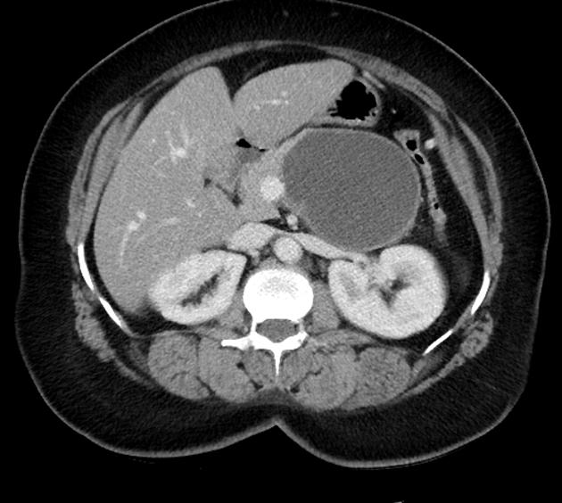
Always* call the surgeon!
Mucinous cystadenoma
* Sure?

Slide 54
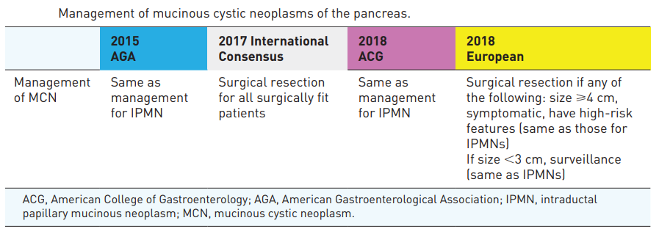

Slide 55
Actual malignancy risk of either operated or non-operated presumed mucinous cystic neoplasms of the pancreas under surveillance
424 observed MCNs
Only 1/10 of resected MCNs is malignant:
Mural nodules (OR 27.8)
Size ≥5 cm (OR 13.4)
Ca 19-9 increase (OR 3.9)
In the absence of these features, the incidence of malignancy is negligible, favouring surveillance in selected patients given the low risk of malignancy and the high rate of misdiagnosis.
Surveillance seems a good option when:
No mural nodule
cyst< <5cm
Normal Ca19-9
Br J Surg 2021; 108(9): 1097-1108.

Slide 56
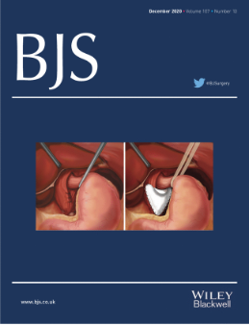
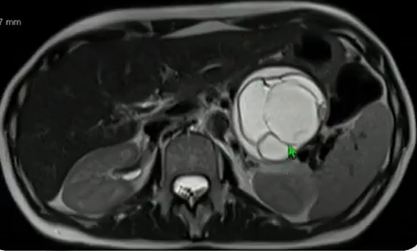
Actual malignancy risk of either operated or non-operated presumed mucinous cystic neoplasms of the pancreas under surveillance
Why should we postpone surgery:
(usually) young age
(usually) no symptoms
Postoperative morbidity/mortality
Risk of diabetes
Br J Surg 2021; 108(9): 1097-1108.

Slide 57
Please call the surgeon!

Slide 58
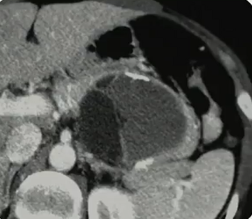
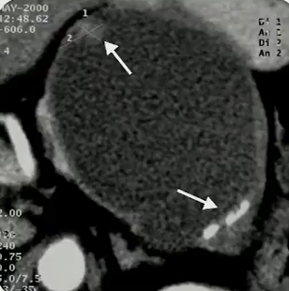
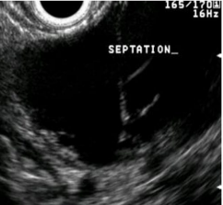
MCN at radiology
Please call the surgeon!

Slide 60
Case 6
Patient A 43-year-old woman
abdominal pain
US a hypoechoic lesion in the tail of the pancreas
CA 19-9 43 U/ml

Slide 61
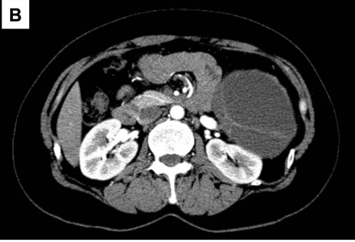
The large cystic lesion in the pancreatic tail. The wall and septum show enhancement.

Slide 62
Case 6
Next step: EUS, surgery, follow-up?

Slide 63
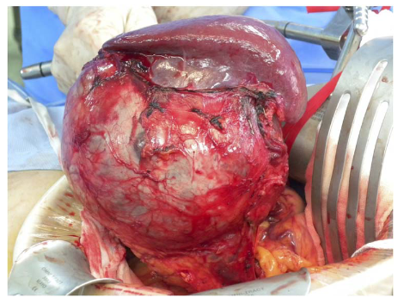
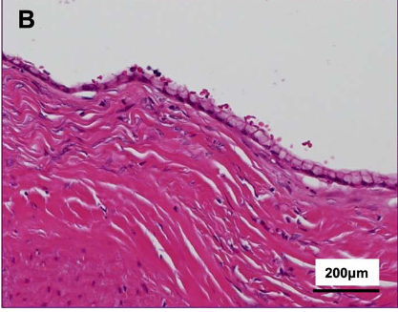
Case 6
Directly underwent surgery
Final diagnosis: Mucinous cystic neoplasm with low-grade dysplasia

Slide 64
Case 7
Patient A 53-year-old woman
Nonspecific abdominal pain
US A anechoic lesion in the body of the pancreas
CA 19-9 33 U/ml

Slide 65
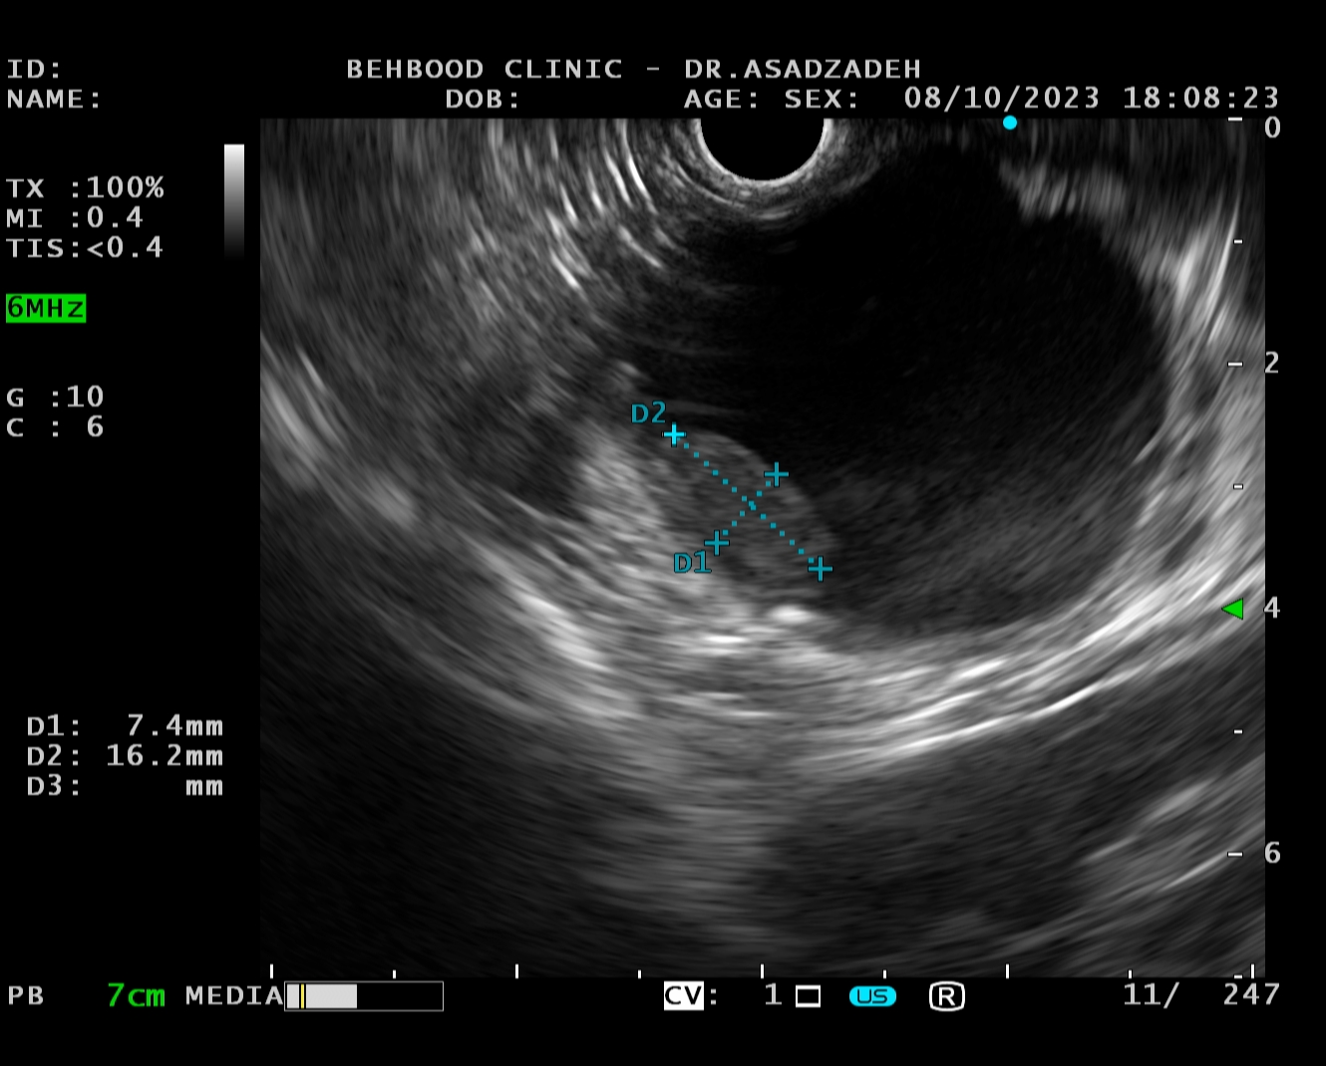
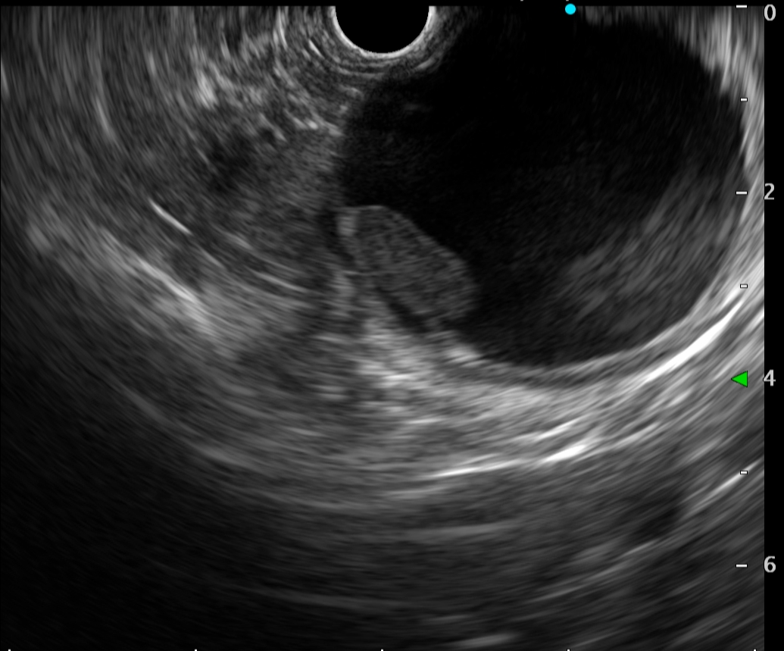
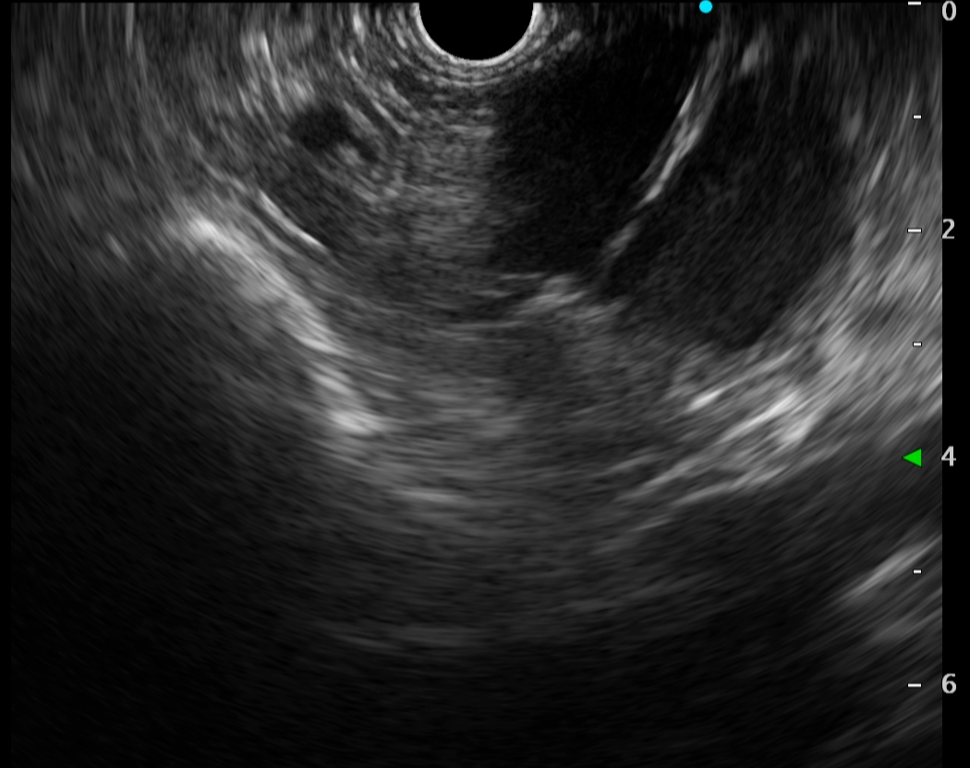
Dr Sadeghi
48mm
Mural nodule
Septations

Slide 66
Case 7
Next step: EUS, surgery, follow-up?

Slide 67
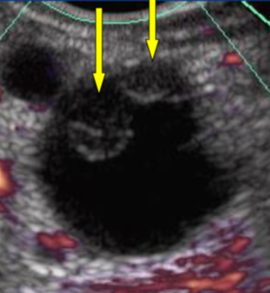
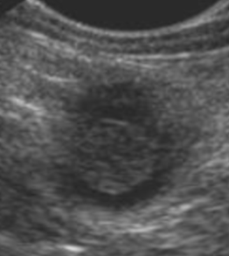
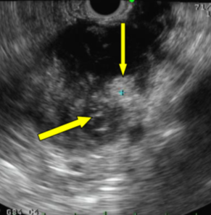
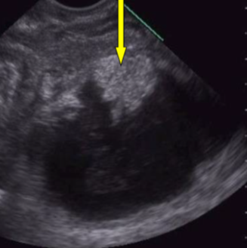
Malignant predictors in mucinous neoplasms
Mural nodule
Mucus
Echogenic lesion (tissue)
Hypoechoic compared with adjacent soft tissue
Smooth edge
Hyperechoic rim
Hyperechoic compared with adjacent soft tissue
Irregular edge
Hyperechoic rim absent

Slide 68
Harima et al. WJG 2015
Enhanced mural nodule
Mucus

Slide 69
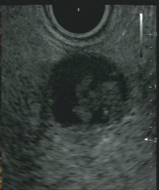
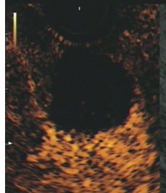
Malignant predictors in mucinous neoplasms
Mural nodule
Greatest performance of CE-EUS
In characterizing mural nodules:
Sensitivity = 97%
Specifity = 90%
Diagnostic accuracy = 89%
No need for biopsy to substantiate surgical indication
Mucin

Slide 70
DFI-EUS

Slide 71
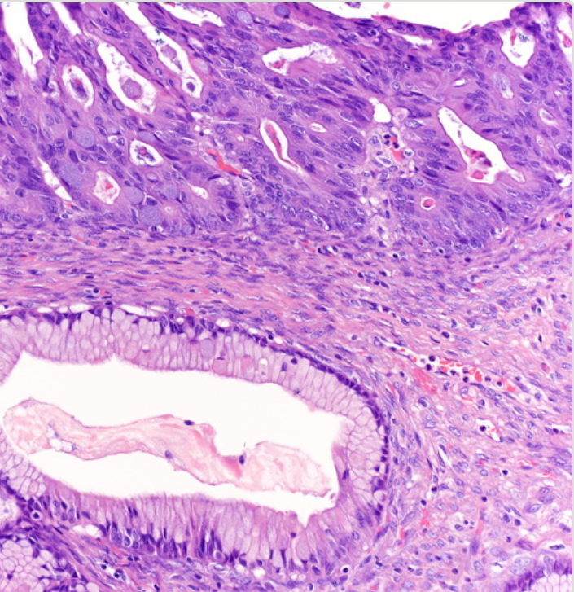
Case 7
Directly underwent surgery
Final diagnosis: Mucinous cystic neoplasm with high-grade dysplasia

Slide 72
Case 8
Patient 75 yr old male
Hx of myocardial infarction
Asymptomatic
MRI/MRCP Suspected IPMN-BD ; 2cm
No worrisome features
Has been followed for 5 yrs, unchanged
Doctor. Can I stop surveillance

Slide 73
Case 8

Slide 74
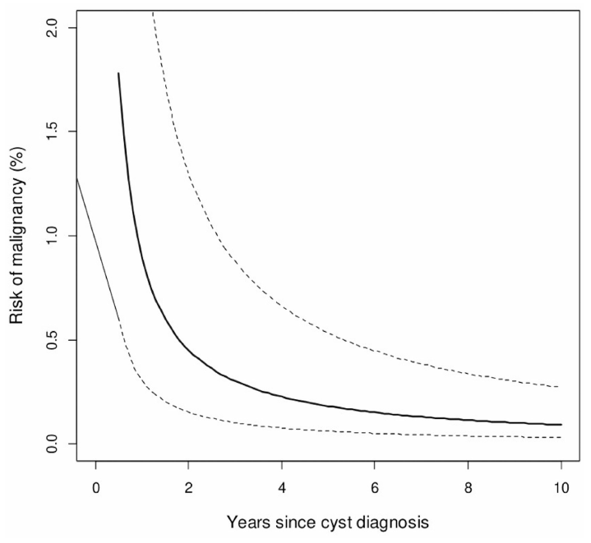
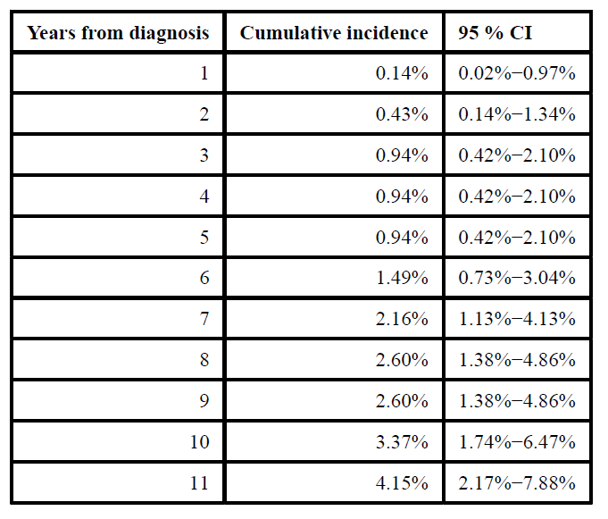
When is it time to stop surveillance?
Risk of progression beyond 5 years of follow-up
806 patients with pancreatic cysts measuring <15mm and without worrisome features
The risk of malignancy in small pancreatic cysts decreases over time.
Cumulative incidence of malignancy was found to be 0.94% and 3.37% at 5 and 10 years.
Ciprani D et al. Pancreatology. 2020; 20(6): 1213–1217.

Slide 75
The current strategy (only for IPMN)
Low risk:
No worrisome features or
high risk stigmata
Intermediate risk:
Size ≥ 4cm
Grow-rate ≥ 5mm/yr
New onset of diabetes mellitus
Acute pancreatitis (caused by IPMN)
CA 19.9 >37 U/mL (if no jaundice)
Enhancing mural nodule (<5 mm)
MPD dilatation between 5 and 9.9 mm
High risk:
Enhancing mural nodule (≥5 mm)
MPD dilatation ≥10 mm
Jaundice (tumour related)
Solid mass
Positive cytology
Observe and lengthen interval if stable
Closely observe or operate if presumed risk of malignancy outweights the risk of surgery
Endoscopic ultrasonography ± FNA
If uncertainty/concern
Operate if fit for surgery
Discontinue FU after 5 years if stable and ≤ 15mm?
FU after partial pancreatectomy
FU after partial pancreatectomy
The European Study Group on Cystic Tumours of the Pancreas. Gut 2018;67:789–804.

Slide 77
GRADE 1B, strong agreement
European guidelines GUT 2018;67:138-45.

Slide 79
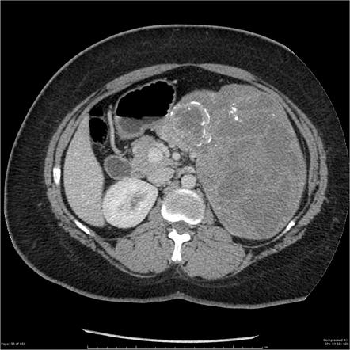
Always call the surgeon!
Solid pseudo-papillary tumor

Slide 80
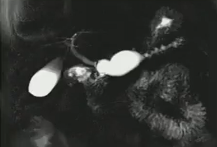
Always* call the surgeon!
Main duct IPMN
*Sure?
**Aren't you overtreating?

Slide 81
با سپاس از توجه شما

